Slide 1
Advanced Algorithms
Spring 2021
Lecture 1

Slide 2
Agenda for Today
Welcome back to a new semester !!
We are hopefully seeing the last embers of the pandemic.
Nevertheless, we have to prepare for a possibly new normal in many ways.
We will continue to teach and learn in the online mode for Spring 2021 too.
Stay safe, but curious!

Slide 3

Agenda for Today
Welcome back to a new semester !!
We are hopefully seeing the last embers of the pandemic.
Nevertheless, we have to prepare for a possibly new normal in many ways.
We will continue to teach and learn in the online mode for Spring 2021 too.
Stay safe, but curious!
My details
Kishore Kothapalli, Professor, IIIT Hyderabad
Email: kkishore@iiit.ac.in (the best way to reach me)
Research interests span parallel computing and distributed algorithms.

Slide 4
Agenda for Today
Rest of Today’s Class
Syllabus
Policies
Expectations
Actual lecture

Slide 5
Syllabus
Roughly, a three module course
Module 1: Randomized Algorithms
Module 2: Parallel and Distributed Algorithms
Module 3: Advanced Topics
Big data and Sampling
Algorithm engineering
Any other

Slide 6
Syllabus
Roughly, a three part course
Randomized Algorithms
Chernoff bounds and Randomized Routing
Perfect Hashing
Graph algorithms: MIS, Spanners
Randomized Rounding
Approximate counting
Parallel and Distributed Algorithms

Slide 7
Syllabus
Roughly, a three part course
Randomized Algorithms
Parallel and Distributed Algorithms
Flynn’s Taxonomy and Models of Computations
Basic parallel algorithms: Search/Sort/Scan/Merge
Tree and Graph Algorithms
Lower Bounds

Slide 8

Policies
Grading (Tentative)
Homeworks: 30% (We will have some lateness policy here)
In-class Quizzes : 25% (We will have some redundancy here)
End Exam: 15%
Quizzes 1 and 2 : 30%
Exceptional Performance: 5% extra
Any submission that is graded and evaluated should not be copied from any source.
Copied submissions will get zero for the first instance and negative for repeat offences.

Slide 9
Support Staff
We have two Teaching Assistants named so far:
Sayantan Jana, sayantan.jana@research.iiit.ac.in
Athreya Chandramouli, athreya.chandramouli@research.iiit.ac.in

Slide 10
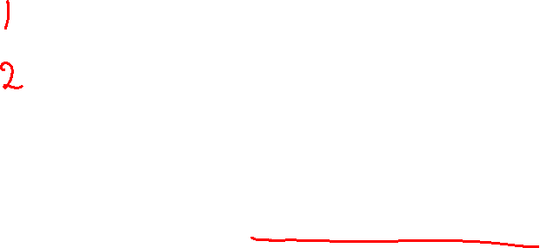
Policies
Textbooks: Do not own these books just for the class!
Randomized Algorithms, Motwani and Raghavan
Introduction to Parallel Algorithms, J. JaJa
Other material to be posted on the course website
Most welcome to write to me if you have any questions.

Slide 11
Expectations
Utilize class time effectively.
Starts with all of you settling by the class time.
Ask any question you may have. No question is small to ask.
Do not show up late.

Slide 12

Agenda for Today
On to the actual lecture….randomization in computing
We will see how randomization can help in designing and analyzing algorithms.
Starting with a very simple example...

Slide 13

A Simple Example
Let us recall the partition procedure and quick sort.
We assume that the elements of the set are all distinct.
S
S₁
S₂
x_{i}
Partition
< x_{i}
x_{i}
> x_{i}
Algorithm RandQuickSort(S)
Choose a pivot element x_{i} u.a.r from S
Split the set S into two subsets S₁ = {x_{j}|x_{j} < x_{i}} and S₂ = {x_{j}|x_{j} > x_{i}} by comparing each x_{j} with x_{i}
Recurse on sets S1 and S2
Output the sorted set S₁, x_{i}, and then sorted S₂.
end Algorithm

Slide 14

A Simple Example
Algorithm RandQuickSort(S)
Choose a pivot element x_{i} u.a.r from S
Split the set S into two subsets S₁ = {x_{j}|x_{j} < x_{i}} and S₂ = {x_{j}|x_{j} > x_{i}} by comparing each x_{j} with x_{i}
Recurse on sets S1 and S2
Output the sorted set S₁, x_{i} and then sorted S₂.
end Algorithm
Let T(n) be the time taken by the procedure.
What can we say about T(n)?

Slide 15

A Simple Example
Algorithm RandQuickSort(S)
Choose a pivot element x_{i} u.a.r from S
Split the set S into two subsets S₁ = {x_{j}|x_{j} < x_{i}} and S₂ = {x_{j}|x_{j} > x_{i}}
Recurse on sets S1 and S2
Output the sorted set S₁, x_{i} and then sorted S₂.
end Algorithm
What can we say about T(n)?
The maximum value of T(n) occurs when the pivot element x_{i} is the largest/smallest element of the remaining set during each recursive call of the algorithm.
In this case, T(n) = n + (n − 1) + · · · + 1 = O(n²).
This value of T(n) is reached with a very low probability of 1/n ·1/ n−1 · · · · 1/2. 1 = 1/n! .
Also, the best case occurs when every pivot element splits the applicable set into two equal sized subsets and then T(n) = O(n ln n).

Slide 16
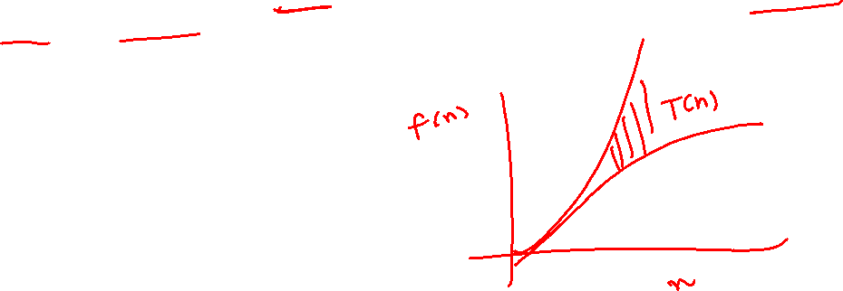
A Simple Example
Algorithm RandQuickSort(S)
Choose a pivot element x_{i} u.a.r from S
Split the set S into two subsets S₁ = {x_{j}|x_{j} < x_{i}} and S₂ = {x_{j}|x_{j} > x_{i}}
Recurse on sets S1 and S2
Output the sorted set S₁, x_{i} and then sorted S₂.
end Algorithm
This implies that T(n) has a distribution between O(n ln n) and O(n²).
Now we derive the expected value of T(n).

Slide 17
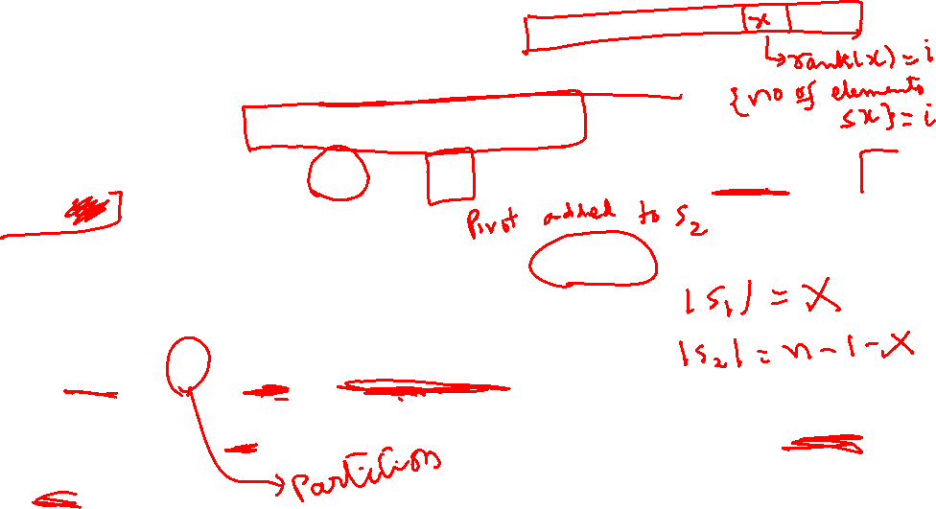
A Simple Example
This implies that T(n) has a distribution between O(n ln n) and O(n²).
Now we derive the expected value of T(n).
Note that if the i^{th} smallest element is chosen as the pivot element then S₁ and S₂ will be of sizes i − 1 and n − i − 1 respectively.
And this choice has a probability of 1/n.
Hence, the recurrence relation for T(n) is:
T(n) = n +T(X) +T(n − 1 −X)
In the above, X is a random variable indicating the size of S₁.

Slide 18
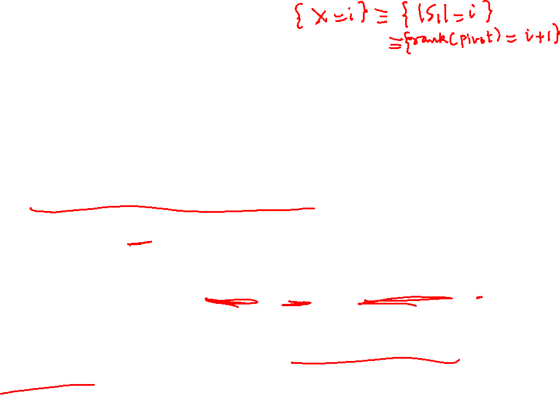
A Simple Example
Note that if the ith smallest element is chosen as the pivot element then S1 and S2 will be of sizes i − 1 and n − i − 1 respectively.
Hence, the recurrence relation for T(n) is:
T(n) = n +T(X) +T(n − 1 −X)
In the above, X is a random variable indicating the size of S₁.
Further, note that Pr[ X = i] = 1/n = Pr[ n – 1 – X = i] as Pr[X = i ] = 1/n.
The last part is true since the choice of the pivot is uniform.

Slide 19
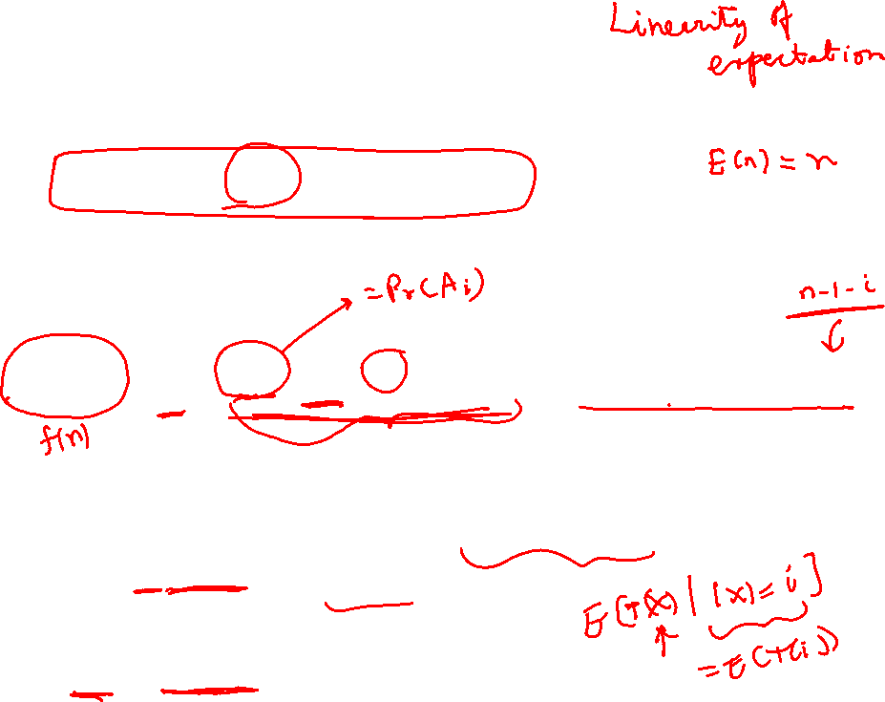
A Simple Example
Hence, the recurrence relation for T(n) is:
T(n) = n +T(X) +T(n − 1 −X)
Further, note that Pr[ X = i] = 1/n = Pr[ n – 1 – X = i] as Pr[X = i ] = 1/n.
Taking expectations on both sides,
E[T(n)] = n + 1/ n Σ_{i=1} ^{n−1} E[T(i)] + (1/n) Σ_{i=1} ^{n−1} E[T(i)].
Use the fact that for a random variable Y with its support partitioned into sets A₁, A₂, …, A_{n}, we have that E[Y] = Σ_{i} Pr(A_{i}) . E[Y | A_{i}].
Let f(i) = E[T(i)].

Slide 20
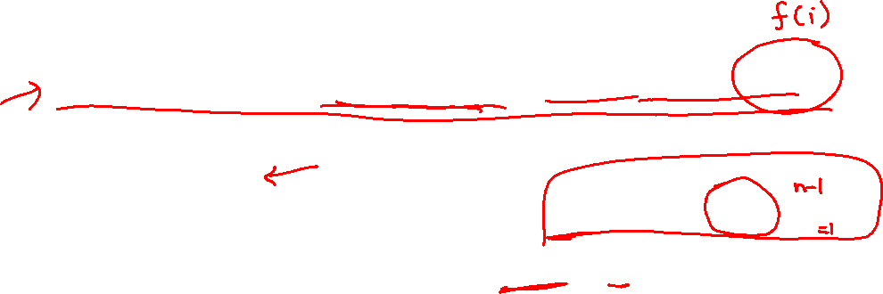
A Simple Example
Taking expectations on both sides of,
E[T(n)] = n + 1/ n Σ_{i=1} ^{n−1} E[T(i)] + (1/n) Σ_{i=1} ^{n−1} E[T(i)].
Let f(i) = E[T(i)].
We can simplify the expression as f(n) = n + (2/n) Σ_{i} f(i).
Further simplification results in nf(n) = n² + 2(f(1) + f(2) + ... + f(n – 1) ).

Slide 21

A Simple Example
Further simplification results in
nf(n) = n² + 2(f(1) + f(2) + ... + f(n – 1) ).
Write the above by replacing n with n – 1 to get
(n – 1) f(n-1) = (n-1)² + 2(f(1) + f(2) + ... + f(n – 2) ).
Subtract the two equation to get:
nf(n) = n² + 2(f(1) + f(2) + ... + f(n – 1) ).

Slide 22
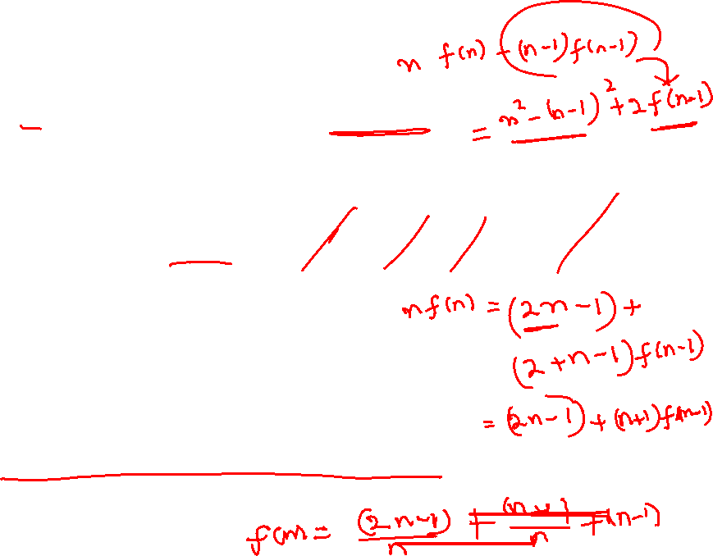
A Simple Example
Further simplification results in
nf(n) = n² + 2(f(1) + f(2) + ... + f(n – 1) ).
Write the above by replacing n with n – 1 to get
(n – 1) f(n-1) = (n-1)² + 2(f(1) + f(2) + ... + f(n – 2) ).
Subtract the two equation to get:
nf(n) = n² + 2(f(1) + f(2) + ... + f(n – 1) ).
or f(n) = (n+1)/n f(n – 1) + (2n – 1)/n.
We prove by induction that f(n) ≤ 2n ln n.

Slide 23
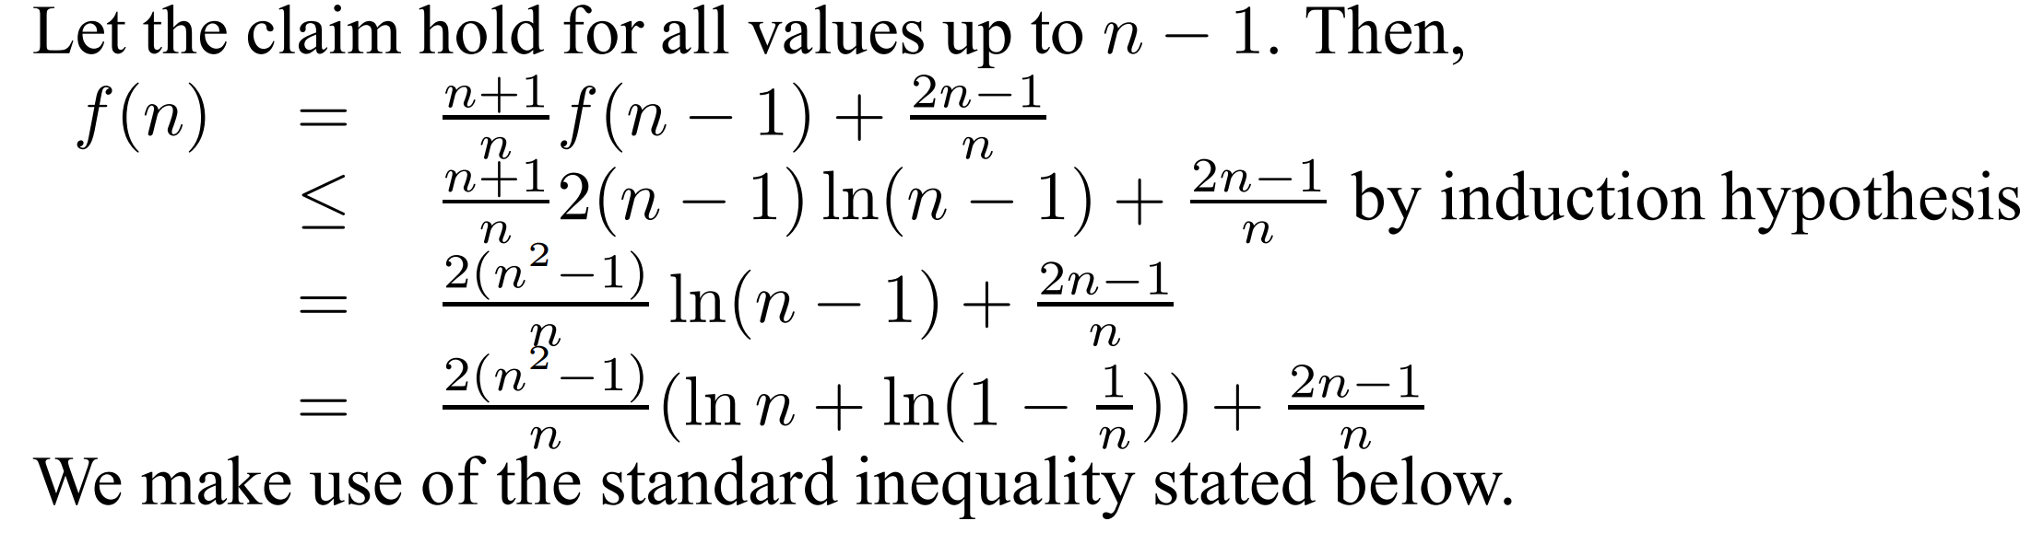
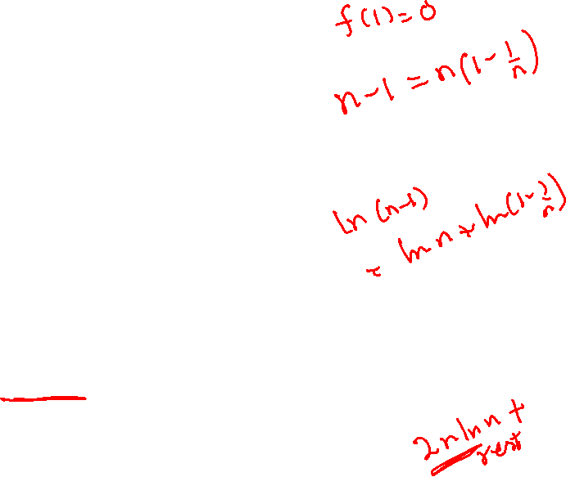
A Simple Example
f(n) = (n+1)/n f(n – 1) + (2n – 1)/n.
We prove by induction that f(n) ≤ 2n ln n.
Check the base case for n = 1.
Let the result hold for all values of n up to n – 1.
Induction step:

Slide 24
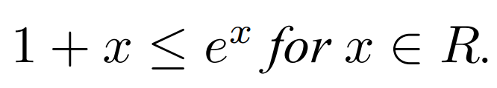
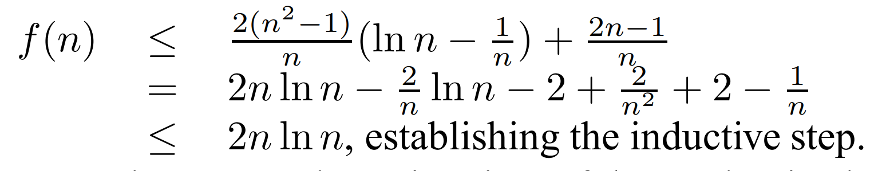
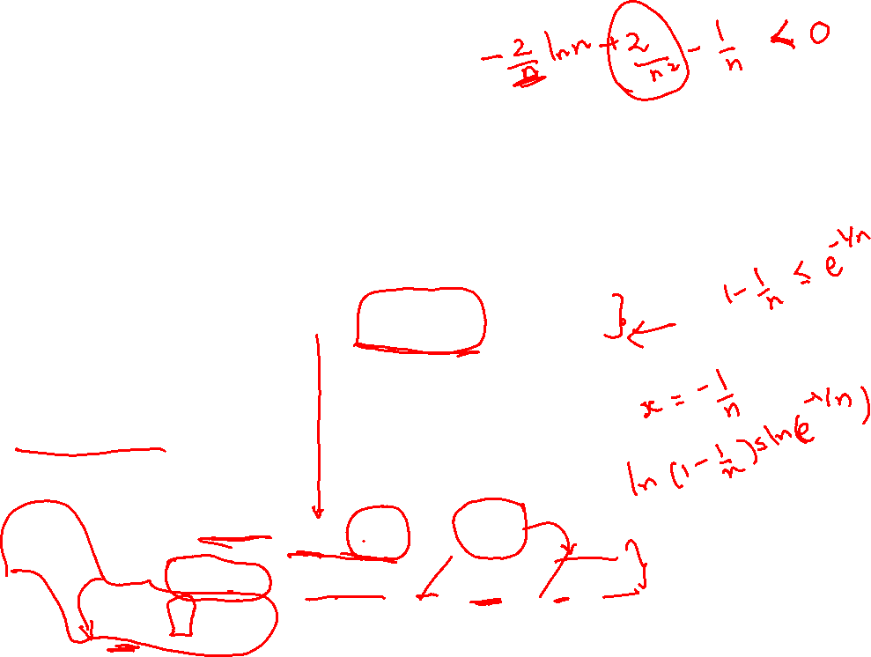
A Simple Example
Hence,

Slide 25
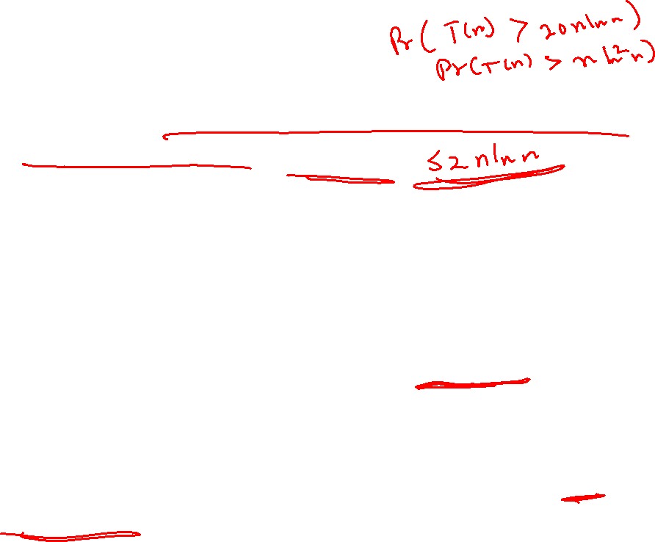
A Simple Example
Hence, the expected running time of the randomized quick sort algorithm is O(n ln n).
But one of the limitations of the recurrence relation approach is that we do not how the running time of the algorithm is spread around its expected value.
Can this analysis be extended to answer questions such as, with what probability does the algorithm RandQuickSort needs more than 12n lnn time steps?
Later on, we apply a different technique and establish that this probability is very small.
To be able to answer such queries, we study Tail inequalities in the following.

Slide 26
Tail Inequalities
We study three ways to estimate the tail probabilities of random variables.
It will be noted that, the more information we know about the random variable the better the estimate we can derive about a given tail probability.

Slide 27
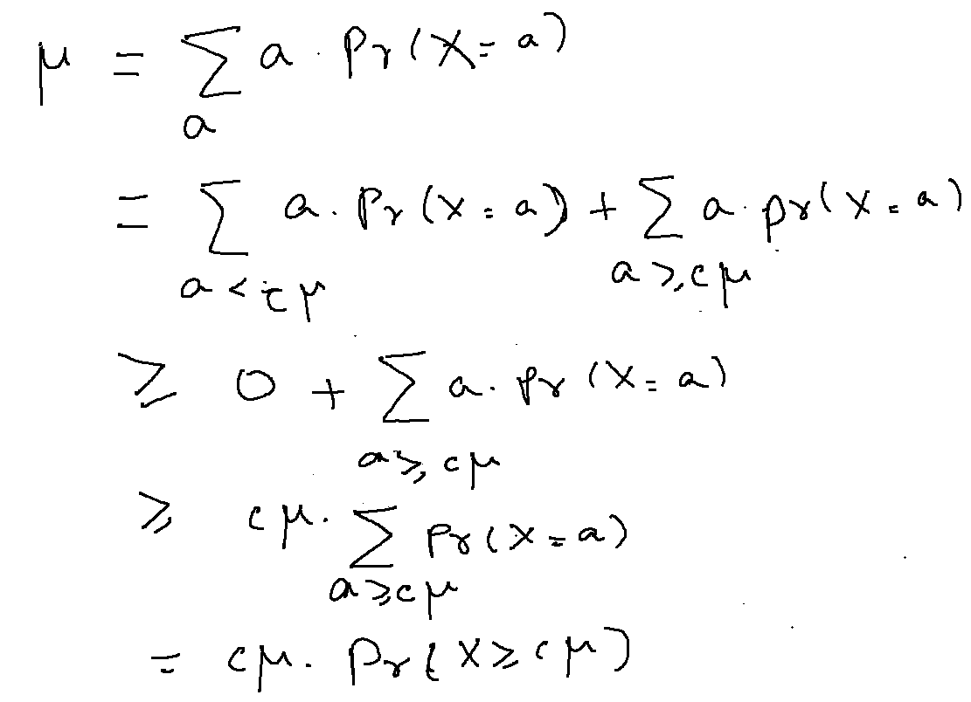







Tail Inequalities
Markov Inequality: If X is a non-negative valued random variable with an expectation of µ, then Pr[X ≥ cµ] ≤ 1/c.
Proof of Markov inequality:

Slide 28
Tail Inequalities
Markov Inequality: If X is a non-negative valued random variable with an expectation of µ, then Pr[X ≥ cµ] ≤ 1.
Applying this inequality tells us that the randomized quick sort algorithm has a run time of more than twice its expectation with a probability of 1/2.
The run time is n² with probability of nearly log n /n.

Slide 29
Tail Inequalities
Chebychev Inequality : We first define the terms standard deviation and variance of a random variable X.
Let X be a random variable with an expectation of µ. The variance of X, denoted by var(X), is defined as var(X) = E[(X − µ)²]. The standard deviation of X, denoted by σ_{X}, is defined as σ_{X} = var(X).
Note that by definition, var(x) = E[(X−µ)²] = E[X²−2Xµ+µ²] = E[X²]−µ².
The second equality follows from the linearity of expectations.

Slide 30


















Tail Inequalities
Chebychev inequality: Let X be a random variable with expectation µX and standard deviation σX.
Then, Pr[|X − µ_{X}| ≥ cσ_{X}] ≤ 1/c²

Slide 31
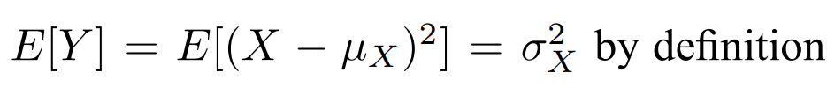

Tail Inequalities
Chebychev inequality: Let X be a random variable with expectation µ_{X} and standard deviation σ_{X}.
Then, Pr[|X − µ_{X}| ≥ cσ_{X}] ≤ 1
Proof. Let random variable Y = (X − µ_{X})². Then,

Slide 32
Tail Ine qualities
Better tail inequalitites can be obtained by the powerful technique called Chernoff bounds.
However, applicability is a little restricted too.
Let us study the most popular version to start with.

Slide 33
Tail Ine qualities
Let X be a random variable defined as the sum of n independent and identically distributed random variables X₁, X₂, ..., X_{n}.
In other words, X = Σ_{i} X_{i}
Short form i.i.d.
Let us assume that each X_{i} is a Bernoulli random variable.
In other words, each X_{i} takes values in {0, 1}.
Let Pr(X_{i} = 1) = p and hence Pr(X_{i} = 0) = 1 – p.
Finally, let E[X] = μ.
Notice that E[X] = Σ_{i} E[X_{i}] = n. (1.p + (1-p).0)) = np.

Slide 34
Tail Ine qualities
Several settings relate to the above statements.
Consider throwing a (biased) coin over n trials.
Each trial, the probability of Heads is p.
So, each X_{i} corresponds to the fact that the ith trial results in a Heads.
Let us count the number of Heads over the n trails. Indeed, X = Σ_{i} X_{i} captures this count as a random variable.
Note that the expected number of Heads over n trails is exactly np.

Slide 35
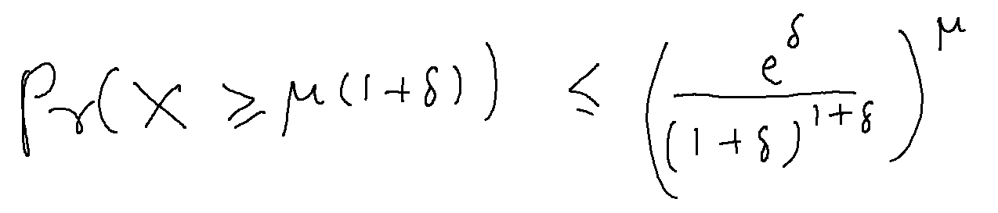
Tail Ine qualities
Finally, to the theorem.
Given the earlier conditions, it holds that for any δ >0,
The normal strategy employed to prove tail estimates of sums of independent random variables is to make use of exponential moments.
While proving Chebychev inequality, we made use of the second-order moment. It can be observed that using higher order moments would generally improve the bound on the tail inequality.
But using exponential moments would result in a vast improvement.

Slide 36
Tail Ine qualities
Given the earlier conditions, it holds that for any δ >0,
While proving Chebychev inequality, we made use of the second-order moment of a random variable.
It can be observed that using higher order moments would generally improve the bound on the tail inequality
But using exponential moments would result in a vast improvement in the bound.
An exponential moment of a random variable X is the expectation of functions of X such as e^{X}.

Slide 37
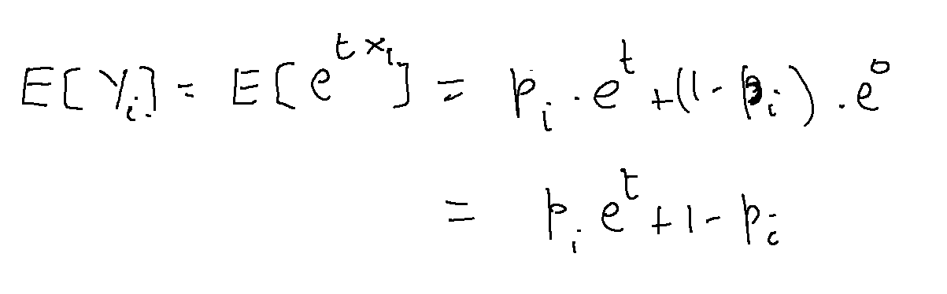
Tail Ine qualities
Given the earlier conditions, it holds that for any δ > 0,
For each i, we define the random variable Y_{i} = e^{tXi} for a real number t > 0 that will be chosen later.
Notice that
Y_{i} is a positive valued random variable.

Slide 38
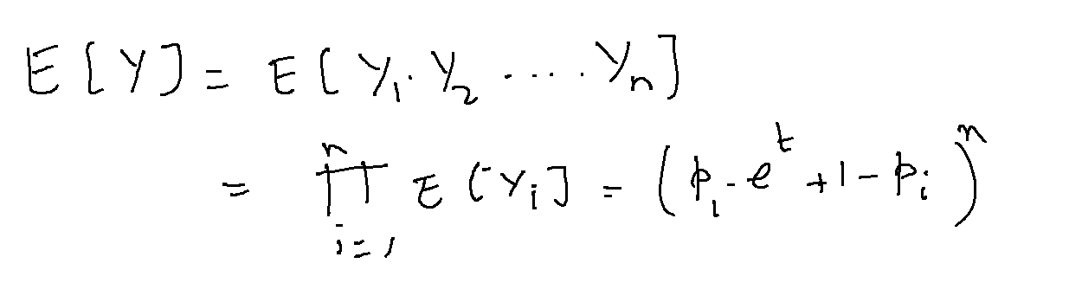
Tail Ine qualities
Given the earlier conditions, it holds that for any δ > 0,
Now define another random variable Y = Y₁.Y₂....Y_{n}.
Now, we can note that
Why does the above calculation hold?

Slide 39
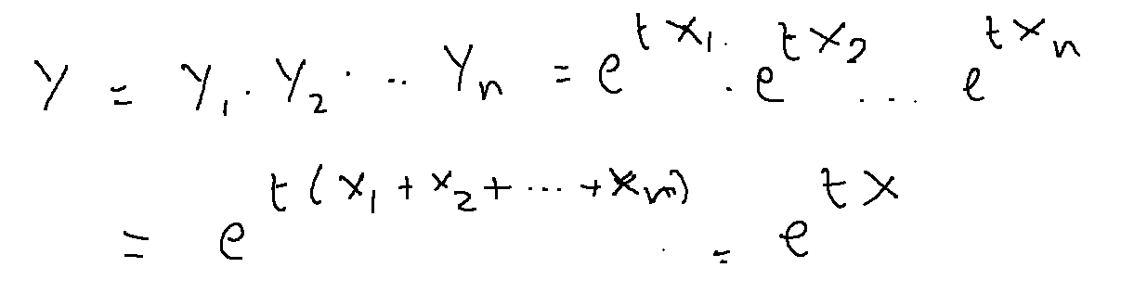
Tail Ine qualities
Given the earlier conditions, it holds that for any δ > 0,
The next step we do is do apply Markov inequality on Y as follows.
First, notice that Y = e^{tX} as

Slide 40
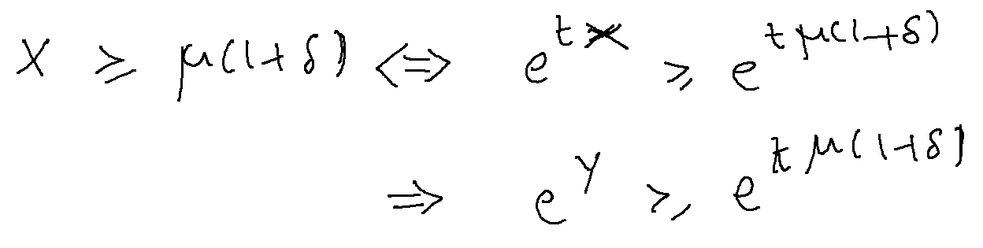
Tail Ine qualities
Given the earlier conditions, it holds that for any δ > 0,
First, notice that Y = e^{tX}. And,
Further,
So, we are interested in the event Y ≥ e^{tμ(1+δ)}.

Slide 41
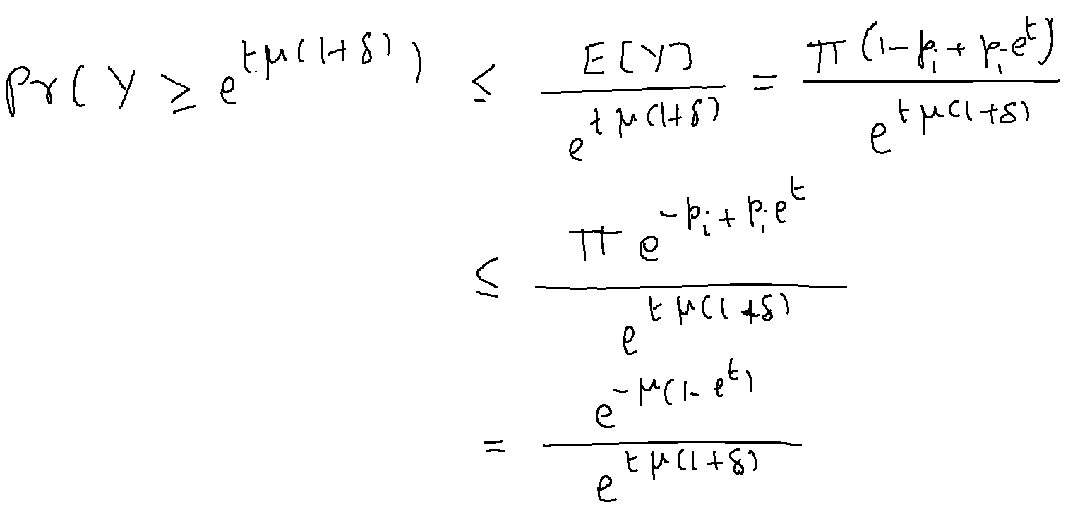
Tail Ine qualities
Given the earlier conditions, it holds that for any δ > 0,
So, we are interested in the event Y ≥ tμ(1+δ). We proceed as:

Slide 42
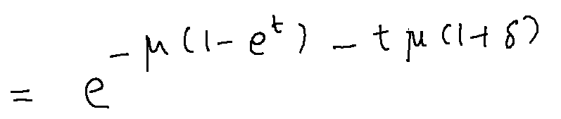
Tail Ine qualities
Given the earlier conditions, it holds that for any δ > 0,
So, we are interested in the event Y ≥ tμ(1+δ). We proceed as:

Slide 43
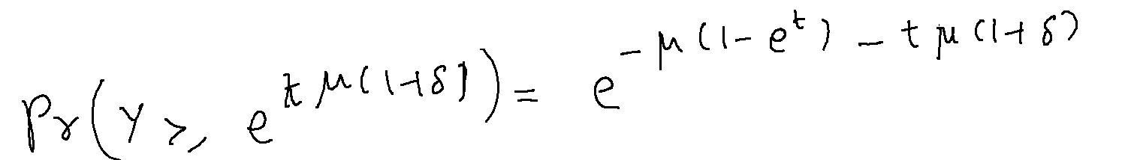
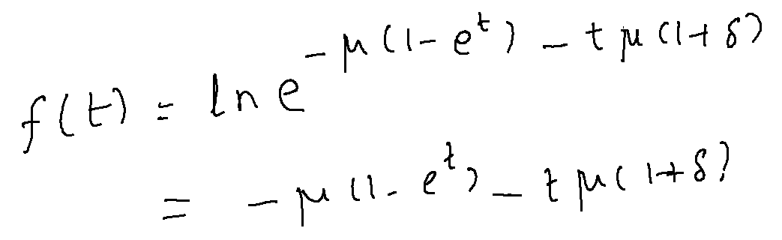
Tail Ine qualities
Given the earlier conditions, it holds that for any δ > 0,
So,
Since t is a free parameter in the above, we can find a t that minimizes the right hand side.
To simplify, let

Slide 44
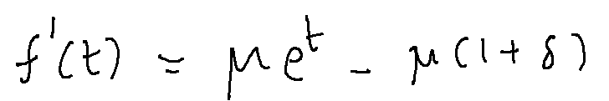
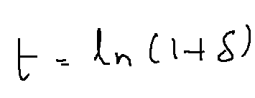
Tail Ine qualities
Given the earlier conditions, it holds that for any δ > 0,
To simplify, let
Differentiating f(t) wrt t, we get
So, f’(t) = 0 at
Verify that the above t corresponds to a minima. OFFLINE.

Slide 45
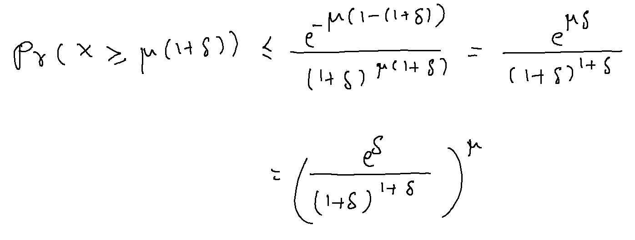
Tail Ine qualities
Given the earlier conditions, it holds that for any δ > 0,
With t = ln(1+δ), we get that
completing the proof.

Slide 46
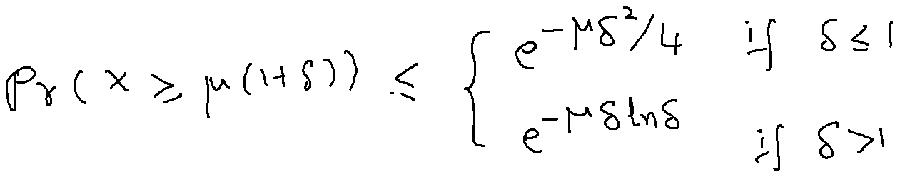
Tail Ine qualities
Given the earlier conditions, it holds that for any δ > 0,
With t = ln(1+δ), we get that
A simplification of the RHS gives

Slide 47
A Simple Example
Here is one more practical application of the Chernoff bounds.
Consider once again counting the number of heads out of tossing n fair coins independently.
So, p = ½.
Let X_{i} denote the random variable that takes 1 if the ith coin toss results in a head, and 0 otherwise.
E[X_{i}] = ½.
Let X = Σ_{i} X_{i}
X counts the total number of heads over the n tosses.
E[X] = n/2.
With n = 100, say, we expect 50 heads over 100 coin tosses.

Slide 48
A Simple Example
Markov inequality tells that the probability that X takes a value beyond 70 is Pr (X ≥ 70) = Pr (X ≥ 70/50 x 50) <= 5/7 = 0.7 (approx.)
To apply Chbychev’s inequality, we need to do some extra work.
Var(X_{i}) for any i is computed as E[X_{i}²] – E[X_{i}]².
E [X_{i}²] = 0x(1/2) + 1x(1/2) = ½.
Var(X_{i}) = ½ - (½) ² = ¼.
Var(X) = 100x Var(X₁) due to independence.
So, Var(X) = 100/4 = 25, and σ_{X} = 5.
Now, Pr(X ≥ 70) can be rewritten as Pr(|X – 50| ≥ 20) and further as Pr( |X – 50| ≥ (20x 1/ σ_{X}) σ_{X} ) ) which is now at most 25/400 = 1/16 = 0.0625.

Slide 49
A Simple Example
Markov inequality tells that the probability that X takes a value beyond 70 is Pr (X ≥ 70) = Pr (X ≥ 70/50 x 50) <= 5/7.
Applying Chebychev’s inequality, we get that Pr(X ≥ 70) is at most 1/16.
This is quite an improvement on the upper bound of the probability of the event of interest.
Let us see what Chernoff bounds will allow us to claim.
We start by writing Pr(X ≥ 70) = Pr( X ≥ (1+2/5)x50)).
From Chernoff bounds, this probability is at most exp{20}/(1.4)⁷⁰ = 0.028 (approx.).

Slide 50
Applications of Tail Inequalities
Here is one more practical application of the Chernoff bounds.
Consider dividing a data set with features of interest into two parts: a test set and a training set.
To make sure that both are roughly similar copies, you want to divide so that both data sets have the same number of data items of any given feature.
Similar requirements arise in also experiments related to drug trails.

Slide 51
Example
Candidate | Above 50 Yrs | Diabetic | Frontline worker | Hypertension | Female
C1 | 1 | 0 | 1 | 1 | 0
C2 | 1 | 0 | 0 | 0 | 1
C3 | 0 | 0 | 0 | 0 | 1
C4 | 0 | 1 | 1 | 1 | 0
C5 | 1 | 1 | 0 | 0 | 0

Slide 52
Applications of Tail Inequalities
To simplify matters, we will think of n data items with n features.
Prepare a matrix A of nxn with entries from {0, 1}.
Rows are features, columns are data items
The goal is to find a vector x of size n with entries from {-1, +1} such that Ax has the smallest possible maximum absolute entry.
Rows with +1 in x belong to one class and those with -1 in x belong to another class.
The maximum absolute entry in Ax indicates how many data items differ at feature i according to the division by x.

Slide 53
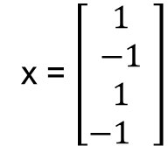
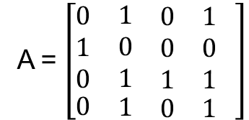
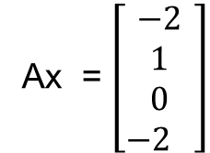
Applications of Tail Inequalities
Example
The maximum absolute entry in Ax is 2.
A = $\left[\begin{matrix}\begin{aligned}0 \\ 1 \\ 0\end{aligned} & \begin{aligned}\begin{matrix}1 & \begin{matrix}0 & 1\end{matrix}\end{matrix} \\ \begin{matrix}0 & \begin{matrix}0 & 0\end{matrix}\end{matrix} \\ \begin{matrix}1 & \begin{matrix}1 & 1\end{matrix}\end{matrix}\end{aligned} \\ 0 & \begin{matrix}1 & \begin{matrix}0 & 1\end{matrix}\end{matrix}\end{matrix} \right]$
x = $\left[\begin{aligned}1 \\ −1 \\ 1 \\ −1 \end{aligned}\right]$
Ax = $\left[\begin{aligned}−2 \\ 1 \\ 0 \\ −2 \end{aligned}\right]$

Slide 54
Applications of Tail Inequalities
No good deterministic algorithms are known.
The brute-force algorithm has to try all possible 2^{n} vectors.
However, a very simple randomized algorithm exists.
Consider choosing each element of x uniformly at random from {1, -1}.
We will show that the maximum absolute entry of Ax in such an x is bounded by O((n ln n)^{1/2}) with high probability.

Slide 55
Applications of Tail Inequalities
Consider choosing each element of x uniformly at random from {1, -1}.
We will show that the maximum absolute entry of AX in such an X is bounded by O((n ln n)^{1/2}) with high probability.
Let the product AX = Y.
Consider any Y_{i}, say Y₁.
By definition of matrix multiplication, Y₁ = A₁₁X₁+A₁₂X₂+ · · ·+A_{1n}X_{n} where the A_{ij} denotes the element of A at the ith row and jth column.

Slide 56
Applications of Tail Inequalities
Consider choosing each element of x uniformly at random from {1, -1}.
We will show that the maximum absolute entry of AX in such an X is bounded by O((n ln n)^{1/2}) with high probability.
Let the product AX = Y.
Consider any Y_{i}, say Y₁.
By definition of matrix multiplication, Y₁ = A₁₁X₁+A₁₂X₂+ · · ·+A_{1n}X_{n}
Note that E[X_{i}] = 0 and by linearity of expectations, E[Y₁] = 0.

Slide 57
Applications of Tail Inequalities
We will show that the maximum absolute entry of AX in such an X is bounded by O((n ln n)^{1/2}) with high probability.
Let the product AX = Y. Consider any Y_{i}, say Y₁.
By definition of matrix multiplication, Y₁ = A₁₁X₁+A₁₂X₂+ · · ·+A_{1n}X_{n}
Note that E[X_{i}] = 0 and by linearity of expectations, E[Y₁] = 0.
Let us imagine the case where the choices of X are made independently.
We can then apply Chernoff bound on Y.

Slide 58
Applications of Tail Inequalities
One small detour before we do that.
In our Chernoff bound derived earlier, each X_{i} is {0,1} valued random variable.
Now, each X_{i} is a +1/-1 valued random variable.
Need a new version of Chernoff bound!

Slide 59
Applications of Tail Inequalities
Consider X as the random variable that is the sum of n independent and identically distributed random variables X_{i} with X_{i} taking value among {-1, +1}.
Let Pr[X_{i} = +1] = Pr[X_{i} = -1] = 1/2.
Note that E[X] = n.E[X_{i}] = n.0 = 0.
We want to know the Prob(X >= k) for some integral k.

Slide 60
Applications of Tail Inequalities
Consider X as the random variable that is the sum of n independent and identically distributed random variables X_{i} with X_{i} taking value among {-1, +1}.
Let Pr[X_{i} = +1] = Pr[X_{i} = -1] = 1/2.
Note that E[X] = n.E[X_{i}] = n.0 = 0.
We want to know the Prob(X >= k) for some integral k.
Instead of doing the entire calculation again, let us do the following.
Define Y_{i} = (1+X_{i})/2. Now, Y_{i} is {0,1} valued.
Define Y as the sum of Y_{i}’s.

Slide 61
Applications of Tail Inequalities
Consider X as the random variable that is the sum of n independent and identically distributed random variables X_{i} with X_{i} taking value among {-1, +1}.
We want to know the Prob(X >= k) for some integral k.
Define Y_{i} = (1+X_{i})/2. Now, Yi is {0,1} valued.
Define Y as the sum of Y_{i}’s.
Note that EY = n/2.
Also, X >= k if and only if Y >= n/2 + k/2.
Now, Pr( X >= k) = Pr(Y >= n/2 + k/2).

Slide 62
Applications of Tail Inequalities
Also, X >= k if and only if Y >= n/2 + k/2.
Now, Pr( X >= k) = Pr(Y >= n/2 + k/2).
Rewrite as Pr(Y >= E[Y](1+(k/n)) with δ = k/n < 1.
Applying Chernoff bounds with the above δ, we get that Pr(Y >= E[Y](1+d)) <= exp(-E[Y]δ²/4) = exp(-δ²/4n).

Slide 63
Applications of Tail Inequalities
Back to our problem of set balancing....
We now get Pr(Y₁ >= 8 √n ln n) ≤ exp(−64n ln n) = exp(−8 ln n) = 1/n⁸.
But we are interested in a two-sided bound.
That is, since we want to minimize the absolute value of Y₁, we need to compute Pr[Y₁ ≤ −d] also.
But by symmetry, we have that Pr(Y₁ <= -d) <= 1/n⁸.
So, Pr[|Y₁| >= (8n ln n)^{1/2}] <= 2/n⁸.

Slide 64
Applications of Tail Inequalities
Back to our problem of set balancing....
So, Pr[|Y₁| >= (8n ln n)^{1/2}] <= 2/n⁸.
But, what about Y₂, Y₃, etc.
This is where another classical probability result aids us.
Boole’s inequality. For any events, E1, E2, ... , En,
Pr(E1 U E2 U .. U En) <= Pr(E1) + Pr(E2) + ... + Pr(En).
Apply the above to get that with probability at least 1-2/n⁷, every Y_{i} has an absolute value that is within (8n ln )^{1/2}.

Slide 65
Applications of Randomization
It is known that randomization combined with (non-trivial) algebraic techniques can lead to important applications.
In this section, we showcase some of such techniques with respect to verification of identities.
One such technique is called the fingerprinting technique described as follows.

Slide 66
Applications of Randomization
Let U be any universe of objects and x and y be any two elements from U.
The question we ask is, Is x = y?
One can answer this using at least log |U| bits in a deterministic manner.
However, consider mapping elements of U to a sparse universe V such that x and y are identical if and only if their images in V are identical, with a good chance.
These images can be thought of as fingerprints of x and y.

Slide 67
Applications of Randomization
Let us apply the above technique to matrix product verification. Let F be a field and A and B are two matrices with entries from F.
Suppose it is claimed that C = A · B.
The fastest known matrix multiplication algorithm runs in time O(n^{2.376}).
This algorithm is very difficult to implement, but the standard algorithms such as the Strassen’s recursive algorithm takes time O(n^{log2 7}).
So, to verify if C is indeed the product of A and B, it takes time equal to multiplying two matrices.

Slide 68
Applications of Randomization
However, a simpler and efficient randomized approach exists.
Let r be any vector with entires being 0 or 1.
Let each element of r be chosen independently and uniformly at random.
It is being assumed without loss of generality that 0 and 1 are the additive and multiplicative identities of the field F.

Slide 69
Applications of Randomization
Compute x = Br, and y = Ax.
Similarly, compute z = Cr.
If A · B = C is indeed true, then y must equal z for any r.
Also, x, y, and z can each be computed in O(n²) time.
So, the time efficiency is established.
It remains to see the verification efficiency.
The following lemma argues that the verification procedure is efficient.

Slide 70
Applications of Randomization
Lemma:1 Let A, B, and C be n × n matrices from F such that AxB ≠ C. Then, for r chosen uniformly at random from {0, 1}^{n}, Pr(ABr = Cr) ≤ 1/2.
Proof. Consider the matrix D := AB − C. Since, AB ≠ C, matrix D is not the matrix of all zeros.
We are interested in the event that Dr = 0.
Assume without loss of generality that the first row of D has a nonzero entry and all all nonzero entries in that row are before any zero entry.

Slide 71
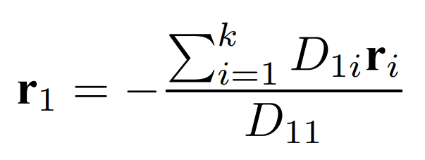
Applications of Randomization
Lemma:1 Let A, B, and C be n × n matrices from F such that AxB ≠ C. Then, for r chosen uniformly at random from {0, 1}^{n}, Pr(ABr = Cr) ≤ 1/2.
Proof.Consider the first row of D and the scalar obtained by multiplying the first row of D with r.
The result is zero if and only if:
In the above, it is assumed that there are k > 0 nonzero elements in the first row of D.

Slide 72
Applications of Randomization
Lemma:1 Let A, B, and C be n × n matrices from F such that AxB ≠ C. Then, for r chosen uniformly at random from {0, 1}^{n}, Pr(ABr = Cr) ≤ 1/2.
Proof. The above event is a super-event of the event that Dr = 0.
Therefore the probability of the event Dr = 0 is upper bounded by the probability of the above event.
To compute the above probability, imagine that all the choices r₂, · · · , r_{k} have been made.
In that case, the right hand side is a scalar from the field F.
The left hand size is a value uniformly chosen amongst (at least) two values in F. The required probability therefore cannot exceed 1/2.

Slide 73
Applications of Randomization
To improve the verification efficiency of the procedure, we can also use repeated independent trials.
Let us perform t independent trials of the above procedure.
For AB ≠ C, the probability that the test fails in each trial is at most 1/2.
So, in t trials, the probability that all t trials fail, or a majority of the t trials fail, is at most (1/2)^{t}.
For t = O(log n), the failure probability is polynomially small

Slide 74
Applications of Randomization
Other applications of the technique include verifying polynomial identities.
For instance, let P₁(x), P₂(x) be two polynomials in a field F.
The polynomial product verification problem is to check whether P₁(x) · P₂(x) = P₃(x) for a given P₃(x).
It holds that there exists an O(n log n) time algorithm to multiply two polynomials, where n is themaximum degree of P₁ and P₂.
We design a verification algorithm that is faster than O(n log n).

Slide 75
Applications of Randomization
Let S ⊂ F be a susbet of size at least 2n + 1.
The main idea of the verification procedure is that if indeed P₃(x) equals P₁(x) · P₂(x), then, also P₃(r) = P₁(r) · P₂(r) for r chosen uniformly at random from S.
Further, evaluating a polynomial at a given input can be done in O(n) time.
So, we can declare that P₃(x) equals P₁(x) · P₂(x) unless P₃(r) ≠ P₁(r) · P₂(r).
The algorithm makes a mistake only when indeed P₃(x) ≠ P₁(x) · P₂(x) but the choice of r fails to detect this.

Slide 76
Applications of Randomization
To estimate the probability that the algorithm makes a mistake, let Q(x) := P₃(x) − P₁(x) · P₂(x).
The degree of Q(x) is at most 2n.
Suppose that P₃(x) ≠ P₁(x) · P₂(x).
Then, Q(x) is a nonzero polynomial.
So the test fails if Q(r) = 0.
However, the polynomial Q(x) of degree at most 2n can have at most 2n roots.
So, the probability that Q(r) = 0 is at most 2n/|S|, which is also the probability of error.
As earlier, the probability of failure can be made polynomially small in n by using repeated trails or choosing a larger S, or both.

Slide 77
Applications of Randomization
One may wonder whether it is at all worthwhile to have elaborate verification algorithms for things as simple as polynomial product verification.
Such techniques however are more applicable when polynomials are not available explicitly.

Slide 78
Finger-Printing
The two algorithms that we considered today have the property that for inputs that are identical, the algorithm does not make any error.
But in inputs that are not identical, the algorithm makes an error that is upper bounded by at least a constant.
Repeated runs of the same algorithm can catch the error, hence the error can be made arbitrarily small.

Slide 79
Finger-Printing
On inputs that are not identical, the algorithm makes an error that is upper bounded by at least a constant.
Repeated runs of the same algorithm can catch the error, hence the error can be made arbitrarily small.
Consider A to be a finger-printing algorithm.
Let us run A on input x, y for t iterations.
The t outputs are, say, o₁, o₂, ..., o_{t}.
If any of these t outputs are NO, then we can return NO as the answer.
If all t are YES, then we return YES as the answer.
Given that x = y,

Slide 80
Finger-Printing
Repeated runs of the same algorithm can catch the error, hence the error can be made arbitrarily small.
Consider A to be a finger-printing algorithm.
Let us run A on input x, y for t iterations.
The t outputs are, say, o₁, o₂, ..., o_{t}.
If any of these t outputs are NO, then we can return NO as the answer.
If all t are YES, then we return YES as the answer.
Given that x = y, Pr(A(x,y) = YES) = 1.
Given that x ≠ y, Pr(A(x,y) = YES) ≤ (1/2)^{t}.
So, if t = O(log n), then the error probability is O(1/n^{c}).

Slide 81
RP and co-RP
The above algorithms are called as co-RP algorithms.
RP stands for Randomized Polynomial.
Definition: The class RP consists of languages L such that there exists a randomized algorithm running in worst case polynomial time such that for any input x:
x ∈ L ⇒ Pr(A accepts x) ≥ 1/2.
x ∉ L ⇒ Pr(A accepts x) = 0
The complement of the class RP is the class co-RP.
Note that any RP or co-RP algorithm can err only on one side, either for x in L, or for x not in L.

Slide 82
RP and co-RP
In definition: The class RP consists of languages L such that there exists a randomized algorithm running in worst case polynomial time such that for any input x:
x ∈ L ⇒ Pr(A accepts x) ≥ 1/2.
x ∉ L ⇒ Pr(A accepts x) = 0
The complement of the class RP is the class co-RP.
In definition: The class co-RP consists of languages L such that there exists a randomized algorithm running in worst case polynomial time such that for any input x:
x ∈ L ⇒ Pr(A accepts x) = 0.
x ∉ L ⇒ Pr(A accepts x) ≤ 1/2.

Slide 83
RP and co-RP
In definition: The class RP consists of languages L such that there exists a randomized algorithm running in worst case polynomial time such that for any input x:
x ∈ L ⇒ Pr(A accepts x) ≥ 1/2.
x ∉ L ⇒ Pr(A accepts x) = 0
In definition: The class co-RP consists of languages L such that there exists a randomized algorithm running in worst case polynomial time such that for any input x:
x ∈ L ⇒ Pr(A accepts x) = 0.
x ∉ L ⇒ Pr(A accepts x) ≤ 1/2
Note that any RP or co-RP algorithm can err only on one side, either for x in L, or for x not in L.

Slide 84
RP and co-RP
In definition: The class RP consists of languages L such that there exists a randomized algorithm running in worst case polynomial time such that for any input x:
x ∈ L ⇒ Pr(A accepts x) ≥ 1/2.
x ∉ L ⇒ Pr(A accepts x) = 0
Can you recall and RP algorithms that we studied?

Slide 85
RP and co-RP
In definition: The class RP consists of languages L such that there exists a randomized algorithm running in worst case polynomial time such that for any input x:
x ∈ L ⇒ Pr(A accepts x) ≥ 1/2.
x ∉ L ⇒ Pr(A accepts x) = 0
Can you recall and RP algorithms that we studied?
The interactive proof algorithm for graph non-isomorphism is an example.

Slide 86
What about Randomized QuickSort
The randomized quick sort algorithm does not make any errors in its output.
So, clearly, it does not fit into either of RP or co-RP.
While there are no errors in its output, we recall that its run time may vary.
Such algorithms are called ZP algorithms.
Stands for Zero Error Expected Polynomial, time
The class ZP consists of languages L such that there is a randomized algorithm A that always outputs the correct answer while running in expected polynomial time.
Another name for ZP algorithms is Las Vegas algorithms.

Slide 87
Proof by Existence
Many times you want to show that a particular combinatorial object exists.
May be very inefficient to build possibly because of a huge space and a small target of interest.
Like finding a needle in a haystack.
This is where randomization can come to the resuce.

Slide 88
Proof by Existence
Two useful statements:
If a random variable has expected value E[X] = a, then certainly there exists a realisation of X with value ≥ a and a realisation of X with value ≤ a.
If a random object drawn from some universe of objects has a certain property with non-zero probability then there must exist an object with that property in this universe.

Slide 89
Proof by Existence
Two useful statements:
If a random variable has expected value E[X] = a, then certainly there exists a realisation of X with value ≥ a and a realisation of X with value ≤ a.
If a random object drawn from some universe of objects has a certain property with non-zero probability then there must exist an object with that property in this universe.
Each of these statements looks simple on their own, but they are remarkably powerful in Computer Science.

Slide 90
Proof by Existence
We will start with a simple example.
Consider an undirected graph G = (V, E).
We want to find a subgraph G’ of G that:
has the largest number of edges of G, and
G’ is bipartite.
We will first show the existence of a G’ with |E(G’)| at least |E(G)|/2.

Slide 91
Proof by Existence
Consider an undirected graph G = (V, E).
We want to find a subgraph G’ of G that:
has the largest number of edges of G, and
G’ is bipartite.
We will first show the existence of a G’ with |E(G’)| at least |E(G)|/2.
The random experiment we perform is to assign a bit 0 or 1, denoted b(v), to each vertex v of G ind. and uar.
Put all vertices in G’.
An edge uv is in G’ if and only if b(u) is different from b(v).

Slide 92
Proof by Existence
The random experiment we perform is to assign a bit 0 or 1, denoted b(v), to each vertex v of G ind. and uar.
Put all vertices in G’.
An edge uv is in G’ if and only if b(u) is different from b(v).
In other words, G’ = (V₀ U V₁, V₀xV₁ int. E(G)).
Let us now bound |E(G’)|.
Let X_{uv} be a random variable that indicates the event {uv in E(G’)}.
E[X_{uv}] = Pr({uv in E(G’)}) = 1/2.

Slide 93
Proof by Existence
The random experiment we perform is to assign a bit 0 or 1, denoted b(v), to each vertex v of G ind. and uar.
An edge uv is in G’ if and only if b(u) is different from b(v).
Let us now bound |E(G’)|.
Let X_{uv} be a random variable that indicates the event {uv in E(G’)}.
E[X_{uv}] = Pr({uv in E(G’)}) = 1/2.
Let X = Σ_{uv in E(G)} X_{uv}.
E[X] = E[Σ_{uv in E(G)} X_{uv}] = Σ_{uv in E(G)} E[X_{uv}] = |E(G)|/2.

Slide 94
Proof by Existence
The random experiment we perform is to assign a bit 0 or 1, denoted b(v), to each vertex v of G ind. and uar.
Let X_{uv} be a random variable that indicates the event {uv in E(G’)}.
E[X_{uv}] = Pr({uv in E(G’)}) = 1/2.
Let X = Σ_{uv in E(G)} X_{uv}.
E[X] = E[Σ_{uv in E(G)} X_{uv}] = Σ_{uv in E(G)} E[X_{uv}] = |E(G)|/2.
By Statement (1) earlier, there must exist an assignment of b() to vertices such that G’ has at least half the edges of G.

Slide 95
Proof by Existence
Let us now move to a more involved example.
We start with the definition of an (α, β, n, d) expander.
A bipartite graph G = (V₁ U V₂, E) on n nodes is an (α, β, n, d) expander if
Every vertex in V1 has degree at most d.
For any subset S of vertices from V₁ such that |S| is at most αn, there are at least β|S| neighbors in V₂.
Ideally, d should be small and β as large as possible.

Slide 96
Proof by Existence
Let us now move to a more involved example.
We start with the definition of an (α, β, n, d) expander.
A bipartite graph G = (V₁ U V₂, E) on n nodes is an (α, β, n, d) expander if
Every vertex in V1 has degree at most d.
For any subset S of vertices from V₁ such that |S| is at most αn, there are at least β|S| neighbors in V₂.
To build such a graph in a deterministic manner is not easy.
Simple randomized construction with d = 18, α = 1/3, and β = 2

Slide 97
Proof by Existence
A bipartite graph G = (V₁ U V₂, E) on n nodes is an (α, β, n, d) expander if
Every vertex in V1 has degree at most d.
For any subset S of vertices from V₁ such that |S| is at most αn, there are at least β|S| neighbors in V₂.
Simple randomized construction with d = 18, α = 1/3, and β = 2.
We will actually not use these values until the very end of the proof.

Slide 98
Proof by Existence
A bipartite graph G = (V₁ U V₂, E) on n nodes is an (α, β, n, d) expander if
Every vertex in V1 has degree at most d.
For any subset S of vertices from V₁ such that |S| is at most αn, there are at least β|S| neighbors in V₂.
Let each vertex v in V1 choose d neighbors in V2 by sampling independently and uniformly at random.
We can even sample with replacement.
In other words, the same choice can be made more than once.
We will still consider only one copy of any multiple choices.

Slide 99
Proof by Existence
A bipartite graph G = (V₁ U V₂, E) on n nodes is an (α, β, n, d) expander if
Every vertex in V1 has degree at most d.
Let each vertex v in V₁ choose d neighbors in V₂ by sampling independently and uniformly at random.
By this construction, each vertex in V1 has degree at most d.
Next, we show the second condition.

Slide 100
Proof by Existence
Condition 2: For any subset S of vertices from V₁ such that |S| is at most αn, there are at least β|S| neighbors in V₂.
Let |V₁| = |V₂| = n.
Let each vertex v in V₁ choose d neighbors in V₂ by sampling independently and uniformly at random.
Consider any subset S of V₁ with |S| = s.
Let T be any subset of V₂ of size < βs.
Consider the event that all the neighbors of vertices in S are in T.
This event occurs with probability (βs/n)^{ds}.

Slide 101
Proof by Existence
Condition 2: For any subset S of vertices from V₁ such that |S| is at most αn, there are at least β|S| neighbors in V₂.
Let |V₁| = |V₂| = n. Let each vertex v in V₁ choose d neighbors in V₂ by sampling independently and uar.
Consider any subset S of V₁ with |S| = s.
Let T be any subset of V₂ of size < βs.
Consider the event that all the neighbors of vertices in S are in T.
This event occurs with probability at most (βs/n)^{ds}.
We have to now look at all possible S and all possible T.

Slide 102
Proof by Existence
Condition 2: For any subset S of vertices from V₁ such that |S| is at most αn, there are at least β|S| neighbors in V₂.
Consider the event that all the ds neighbors of vertices in S of size s are in T.
This event occurs with probability at most (βs/n)^{ds}.
Let us use Boole’s inequality to upper bound the probability of the event that for some S all its neighbors are in T.
We have to now look at all possible S and all possible T.
There are ^{n}C_{s} ways to choose S and ^{n}C_{βs} ways to choose T.

Slide 103
Proof by Existence
Condition 2: For any subset S of vertices from V₁ such that |S| is at most αn, there are at least β|S| neighbors in V₂.
This event occurs with probability at most (βs/n)^{ds}.
There are ^{n}C_{s} ways to choose S and ^{n}C_{βs} ways to choose T.
The probability that for some S all its neighbors are in T is now upper bounded by ^{n}C_{s} . ^{n}C_{βs} . (βs/n)^{ds}.
To simplify, let us use the inequality that for any n and k, ^{n}C_{k} is at most (en/k)^{k}.

Slide 104
Proof by Existence
Condition 2: For any subset S of vertices from V₁ such that |S| is at most αn, there are at least β|S| neighbors in V₂.
The probability that for some S all its neighbors are in T is now upper bounded by ^{n}C_{s} . ^{n}C_{βs} . (βs/n)^{ds}.
To simplify, let us use the inequality that for any n and k, ^{n}C_{k} is at most (en/k)^{k}.
The probability is at most (en/s)^{s} . (en/βs)^{βs} . (βs/n)^{ds}.
Simplifying we get, [(s/n)^{d-β-1} e^{1+β} β^{d-β} ]^{s}.
Use that s is at most αn, for α = 1/3 to simplify to:

Slide 105
Proof by Existence
Condition 2: For any subset S of vertices from V₁ such that |S| is at most αn, there are at least β|S| neighbors in V₂.
The probability that for some S all its neighbors are in T is now upper bounded by ^{n}C_{s} . ^{n}C_{bs} . (βs/n)^{ds}.
The probability is at most (en/s)^{s} . (en/βs)^{βs} . (βs/n)^{ds}.
Simplifying we get, [(s/n)^{d-β-1} e^{1+β} β^{d-β} ]^{s}.
Use that s is at most αn, for α = 1/3 to simplify the above to [(β/3)^{d} (3e)^{1+β} ]^{s}.
Use d = 18 and β = 2 to simplify to [(2/3)¹⁸ (3e)³ ]^{s}.

Slide 106
Proof by Existence
Condition 2: For any subset S of vertices from V₁ such that |S| is at most αn, there are at least β|S| neighbors in V₂.
The probability that for some S all its neighbors are in T is at most (en/s)^{s} . (en/βs)^{βs} . (βs/n)^{ds}.
Use that s is at most αn, for α = 1/3 to simplify the above to [(β/3)^{d} (3e)^{1+β} ]^{s}.
Use d = 18 and β = 2 to simplify to [(2/3)¹⁸ (3e)³ ]^{s}.
Notice that the term in [ ] is at most 1/2. So, the entire probability is at most (1/2)^{s}.

Slide 107
Proof by Existence
Condition 2: For any subset S of vertices from V₁ such that |S| is at most αn, there are at least β|S| neighbors in V₂.
The probability that for some S all its neighbors are in T is at most [(2/3)¹⁸ (3e)³ ]^{s}.
Notice that the term in [ ] is at most 1/2. So, the entire probability is at most (1/2)^{s}.
We used a specific s. But, we need to show the result for all s between 1 to αn.
Apply Boole’s inequality again to get that
Σ_{s > 0} Pr(for some S all its neighbors are in T)
≤ Σ_{s > 0} (1/2)^{s} < 1

Slide 108
Proof by Existence--AnotherExample
Consider the following claim.
There is a bipartite graph G = (L, R, E) such that
|L| = n
|R| = 2^{log2n}
Every subset of n/2 vertices of L has at least 2^{log2n} – n neighbors in R.
No vertex of R has more than 12log² n neighbors.
We want to use the technique of proof by existence to show the above claim.

Slide 109
Proof by Existence--AnotherExample
There is a bipartite graph G = (L, R, E) such that
|L| = n, |R| = 2^{log2n,} . Every subset of n/2 vertices of L has at least 2^{log2n} – n neighbors in R. No vertex of R has more than 12log² n neighbors.
Let every vertex of L choose d neighbors in R independently and uniformly at random.
Choices are made with replacement.
Multiple edges are dropped in favor of one edge.

Slide 110
Proof by Existence--AnotherExample
There is a bipartite graph G = (L, R, E) such that
|L| = n, |R| = 2^{log2n,} . Every subset of n/2 vertices of L has at least 2^{log2n} – n neighbors in R. No vertex of R has more than 12log² n neighbors.
Let every vertex of L choose d neighbors in R independently and uniformly at random.
Let us now estimate the degree of any vertex of R.
Let |R| = r.
We can think of the degree of a vertex v in R as the expectation of the random variable X that indicates how many vertices in L choose v as a neighbor.
Each neighbor in L makes d choices, so we have nd choices in all.

Slide 111
Proof by Existence--AnotherExample
There is a bipartite graph G = (L, R, E) such that
|L| = n, |R| = 2^{log2n,} . Every subset of n/2 vertices of L has at least 2^{log2n} – n neighbors in R. No vertex of R has more than 12log² n neighbors.
Let every vertex of L choose d neighbors in R independently and uniformly at random.
Let |R| = r.
We can think of the degree of a vertex v in R as the expectation of the random variable X that indicates how many vertices in L choose v as a neighbor.
Each neighbor in L makes d choices, so we have nd choices in all.
Let Xi be a random variable if the ith choice is v.

Slide 112
Proof by Existence--AnotherExample
Let |R| = r.
We can think of the degree of a vertex v in R as the expectation of the random variable X that indicates how many vertices in L choose v as a neighbor.
Each neighbor in L makes d choices, so we have nd choices in all.
Let Xi be a random variable if the ith choice is v.
E[Xi] = 1/r.
X = Σ Xi and so E[X] = Σ E[Xi] = nd/r.
Pick d = r.2log² n /n so that E[X] = 2log² n.
Now apply Chernoff bounds on X for the event X >= 12log²n.
Use Boole’s inequality to bound the probability of the bad event for every v in R.

Slide 113
Proof by Existence--AnotherExample
There is a bipartite graph G = (L, R, E) such that
|L| = n, |R| = 2^{log2n,} . Every subset of n/2 vertices of L has at least 2^{log2n} – n neighbors in R.
Let every vertex of L choose d neighbors in R independently and uniformly at random.
We now move to property 1.
Let S be any subset of size n/2 from L.
Let T be any subset of R of size 2^{log2n} – n.
Consider the event that all the neighbors of S are in T.
This happens with a probability of [(2^{log2n} – n)/n]^{nd/2}.

Slide 114
Proof by Existence--AnotherExample
There is a bipartite graph G = (L, R, E) such that
|L| = n, |R| = 2^{log2n,} . Every subset of n/2 vertices of L has at least 2^{log2n} – n neighbors in R.
Let S be any subset of size n/2 from L.
Let T be any subset of R of size 2^{log2n} – n.
Consider the event that all the neighbors of S are in T.
This happens with a probability of [(r – n)/r]^{nd/2}.
Now, consider all possible choices of S and T. The probability that for any S all its neighbors are in some T is upper bounded by: ^{n}C_{n/2} . ^{r}C_{r-n} . [(r– n)/r]^{nd/2}.
We will now show that the above probability is at most 1.

Slide 115
Proof by Existence--AnotherExample
Now, consider all possible choices of S and T. The probability that for any S all its neighbors are in some T is upper bounded by: ^{n}C_{n/2} . ^{r}C_{r-n} . [(r – n)/r]^{nd/2}.
We will now show that the above probability is at most 1.
Use the (in)equalities
^{n}C_{n-k} = ^{n}C_{k} for k between 0 and n.
^{N}c_{k} is at most (en/k)^{k}.
(1+x) is at most e^{x} for any real number x.
The required probability is
( 2e )^{n/2}. (er/n)^{n}. (e)^{-n2d/2r}.
Recall that d = 2log²n . r/n.

Slide 116
Proof by Existence--AnotherExample
Now, consider all possible choices of S and T. The probability that for any S all its neighbors are in some T is upper bounded by: ^{n}C_{n/2} . ^{r}C_{r-n} . [(r – n)/r]^{nd/2}.
We will now show that the above probability is at most 1.
Use the (in)equalities
^{n}C_{n-k} = ^{n}C_{k} for k between 0 and n.
^{N}c_{k} is at most (en/k)^{k}.
(1+x) is at most e^{x} for any real number x.
The required probability is
( 2e )^{n/2}. (er/n)^{n}. (e)^{-n2d/2r}.
Recall that d = 2log²n . r/n and log r = log²n to simplify.

Slide 117
Yet Another Example
Consider a Boolean formula in CNF.
In CNF, each clause is a disjunction of literals
The formula is a conjunction of clauses.
Another name for CNF is Product-of-Sums.

Slide 118
Yet Another Example
We show that for any set of m clauses, there is a truth assignment that satisfies at least m/2 clauses.
Proof: Consider a random assignment of truth values to variables as T/F.
Consider a clause C_{i} of k variables.
C_{i} is not satisfied with probability 2^{-k}.
Define a random variable Zi that indicates the event Ci is satisfied.
E[Zi] = Pr(Ci is satisfied) = 1 – 2^{-k} .
Define Z as the number of clauses satisfied. Z = Σ Zi.
E[Z] = E[Σ Zi] = Σ E[Zi] = m(1 – 2^{-k}) >= m/2 as k >= 1.

Slide 119
Yet Another Example
We show that for any set of m clauses, there is a truth assignment that satisfies at least m/2 clauses.
Proof: Consider a random assignment of truth values to variables as T/F.
E[Z] = E[Σ Zi] = Σ E[Zi] = m(1 – 2^{-k}) >= m/2 as k >= 1.
The above holds irrespective of whether the formula is satisfiable or not.
This version of the problem where we intend to maximize the number of clauses that can be satisfied is called as MAXSAT.
MAXSAT is also NP-hard indicating that no good polynomial solutions exist.

Slide 120
Yet Another Example
This version of the problem where we intend to maximize the number of clauses that can be satisfied is called as MAXSAT.
Define for an instance I, m*(I) to be the maximum number of clauses that can be satisfied.
Let m^{A}(I) be the number of (expected) clauses that can be satisfied by an (randomized) algorithm A.
The ratio m^{A}(I)/m*(I) is the performance ratio of algorithm A.
We seek algorithms that this ratio as close to 1.
The previous approach gives us 1/2 as the ratio.

Slide 121
Yet Another Example
This version of the problem where we intend to maximize the number of clauses that can be satisfied is called as MAXSAT.
The ratio m^{A}(I)/m*(I) is the performance ratio of algorithm A.
We seek algorithms that this ratio as close to 1.
The previous approach gives us 1/2 as the ratio.
Actually the ratio is 1-2^{-k}.
In fact, there are instances where one can satisfy only 1/2 of the clauses.

Slide 122
LP Rounding
This version of the problem where we intend to maximize the number of clauses that can be satisfied is called as MAXSAT.
We now study an approach that does better than 1/2.
Finally, we devise an algorithm that gets us a ratio of 3/4.

Slide 123
LP Rounding
The technique of LP Rounding uses the following approach.
Write the optimization problem as an integer linear program (ILP).
Relax some of the constraints of the ILP in a step called LP Relaxation to conver the ILP to a simpe Linear Program (LP).
Note that LP can be solved in polynomial time. Get an optimal solution to the LP.
Round the solution from LP to satisfy the integrality constraints.
May lose some quality in this step but that is inevitable.

Slide 124
LP Rounding
Let us apply LP rounding to the MAXSAT problem.
Consider a clause C_{i}.
An indicator variable z_{i} with values in {0, 1} is defined to indicate whether C_{i} is satisfied or not.
We now seek to maximize Σ_{i} z_{i}.
For each variable x_{j}, we define an indicator variable y_{j} that takes values 1 or 0 corresponding to x_{j} = True or False respectively.
Since variables can appear in either the pure form or the complemented form, we separate these as follows.

Slide 125
LP Rounding
Let us apply LP rounding to the MAXSAT problem.
Consider a clause C_{i}.
For each variable x_{j}, we define an indicator variable yj that takes values 1 or 0 corresponding to x_{j} = True or False respectively.
Since variables can appear in either the pure form or the complemented form, we separate these as follows.
Define C_{i+} to be the indices of variables that appear in pure form in C_{i}.
Define C_{i-} to be the indices of variables that appear in pure form in C_{i}.

Slide 126
LP Rounding
Let us apply LP rounding to the MAXSAT problem.
Consider a clause C_{i}.
For each variable x_{j}, we define an indicator variable y_{j} that takes values 1 or 0 corresponding to x_{j} = True or False respectively.
Define C_{i+} to be the indices of variables that appear in pure form in C_{i}.
Define C_{i-} to be the indices of variables that appear in pure form in C_{i}.
Now, clause C_{i} is satisfied if it holds that for each i
Σ_{j in Ci+} y_{j} + Σ_{j in Ci-} (1 – y_{j}) > = z_{i}.

Slide 127
LP Rounding
Let us apply LP rounding to the MAXSAT problem.
The entire integer linear program is:
Maximize Σ_{i} Z_{i}
subject to
Σ_{j in Ci+} y_{j} + Σ_{j in Ci-} (1 – y_{j}) > = z_{i} for all i.
where y_{j}, z_{i} in {0, 1} for all i and j.

Slide 128
LP Rounding
Let us apply LP rounding to the MAXSAT problem.
Let us relax the constraints on y_{j} and z_{i} so that they can take values in [0,1]
Note they are real numbers between 0 and 1 now and not just integral necessarily.
We will use u_{j} and v_{i} for the values of the best solution to the relaxed linear program.
We use u’s for the variables and v’s for the clauses.
Notice that Σ_{i} v_{i} is an upper bound on the number of clauses that can be satisfied.
But, the values of u_{j} are not integral, so they do not yet correspond to True/False values in a truth assignment.

Slide 129
LP Rounding
Let us relax the constraints on y_{j} and z_{i} so that they can take values in [0,1]
We will use u_{j} and v_{i} for the values of the best solution to the relaxed linear program.
But, the values of u_{j} are not integral, so they do not yet correspond to True/False values in a truth assignment.
The next step in the technique suggests to round the u_{i}’s so that a truth assignment can be obtained. This step is called randomized rounding.
Our rounding does the following: Set y_{j} to 1 with probability u_{j}.
This sets x_{j} to True with the same probability.

Slide 130
LP Rounding
The next step in the technique suggests to round the u_{j}’s so that a truth assignment can be obtained. This step is called randomized rounding.
Our rounding does the following: Set y_{j} to 1 with probability u_{j}.
This sets x_{j} to True with the same probability.
We now estimate the probability that a clause C_{i} is satisfied.

Slide 131
LP Rounding
We now estimate the probability that a clause C_{i} is satisfied.
Claim: A clause C_{i} with k literals is satisfied with probability at least 1 – (1-1/k)^{k}.v_{i}.
Recall what is v_{i}.
Let us assume wlog that all the variables in C_{i} appear in their pure form.
So, C_{i} = x₁ V x₂ V ... x_{k} for some variables x₁ through x_{k}.
In the relaxed LP, we satisfy the constraint u₁ + u₂ +... + u_{k} >= v_{i}.
C_{i} now remains unsatisfied if the corresponding x₁ through x_{k} are all 0.

Slide 132
LP Rounding
A clause C_{i} with k literals is satisfied with probability at least 1 – (1-1/k)^{k}.v_{i}.
Recall what is v_{i}.
So, C_{i} = x₁ V x₂ V ... x_{k} for some variables x₁ through x_{k}.
In the relaxed LP, we satisfy the constraint u₁ + u₂ +... + u_{k} >= v_{i}.
C_{i} now remains unsatisfied if the corresponding x₁ through x_{k} are all 0.
This happens with probability (1-u_{j}) for each variable and hence with probability Π_{j} (1-u_{j}) for the k variables.
So, C_{i} is satisfied with probability 1 – Π_{j} (1-u_{j}).

Slide 133
LP Rounding
A clause C_{i} with k literals is satisfied with probability at least 1 – (1-1/k)^{k}.v_{i}.
This happens with probability (1-u_{j}) for each variable and hence with probability Π_{j} (1-u_{j}) for the k variables.
So, C_{i} is satisfied with probability 1 – Π_{j} (1-u_{j}).
We claim that the above is minimized when u_{j} = v_{i}/k for each j. (Take the proof as a reading exercise).
So, the probability of interest is 1 – (1 – v_{i}/k)^{k}.
We now claim that the function f(r) = 1 – (1 – r/k)^{k} is at least 1 – (1-1/k)^{k}.r for all r in [0,1].
Take the proof of the above also as a reading exercise. You need to show that the function is concave.

Slide 134
LP Rounding
A clause C_{i} with k literals is satisfied with probability at least 1 – (1-1/k)^{k}.v_{i}.
So, the probability of interest is 1 – (1 – v_{i}/k)^{k}.
We now claim that the function f(r) = 1 – (1 – r/k)^{k} is at least 1 – (1-1/k)^{k}.r for all r in [0,1].
By the above, we conclude that C_{i} is satisfied with probability at least (1-1/k)^{k}.v_{i}.
Now, use linearity of expectations (over clauses) to show that the expected number of satisfied clauses is at least
Σ_{i} (1 – (1-1/k)^{k}).v_{i} >= (1 – 1/e) Σ_{i} v_{i} >= (1-1/e) m*(I).

Slide 135
LP Rounding
There are two algorithms with performance guarantees as shown:
As k, the length of the clause, increases, the first algorithm does better, and as k is small, the latter is better.
k | 1 – (1/2^{k}) | 1 – (1 – 1/k)^{k}
1 | 0.5 | 1.0
2 | 0.75 | 0.75
3 | 0.875 | 0.703
4 | 0.938 | 0.684
5 | 0.969 | 0.672

Slide 136
LP Rounding
The next steps:
We have two algorithms. One guarantees an approximation ratio of at least 1/2.
The other guarantees an approximation ratio of at least 1 - (1 – 1/k)^{k}.
We can use both to achieve an approximation ratio of at least 3/4.
Idea 1 : Run both algorithms and pick the best solution.
Idea 2 : Toss a fair coin and pick an algorithm based on the outcome.........
In both cases, we can show that the expected performance ratio will be at least 3/4.

Slide 137
LP Rounding
We have two algorithms. One guarantees an approximation ratio of at least 1/2. The other guarantees an approximation ratio of at least 1 - (1 – 1/k)^{k}.
We can use both to achieve an approximation ratio of at least 3/4.
Idea 2 : Toss a fair coin and pick an algorithm based on the outcome.........
In this case, the expected number of clauses satisfied is (n₁+n₂)/2.
Here, n₁ and n₂ refer to the expected number of clauses satisfied by the first and the second algorithms.

Slide 138
LP Rounding
We have two algorithms. One guarantees an approximation ratio of at least 1/2. The other guarantees an approximation ratio of at least 1 - (1 – 1/k)^{k}.
Idea 2 : Toss a fair coin and pick an algorithm based on the outcome.........
In this case, the expected number of clauses satisfied is (n₁+n₂)/2.
Here, n₁ and n₂ refer to the expected number of clauses satisfied by the first and the second algorithms.
We will show that (n₁+n₂)/2 >= ¾ Σ_{i} v_{i}

Slide 139
LP Rounding
In this case, the expected number of clauses satisfied is (n₁+n₂)/2.
Here, n₁ and n₂ refer to the expected number of clauses satisfied by the first and the second algorithms.
We will show that (n₁+n₂)/2 >= ¾ Σ_{j} v_{j}
Focus on clauses that have k literals. Then,
n₁ = Σ_{k} Σ_{Cj has k literals} (1 – 2^{-k}) >= Σ_{k} Σ_{Cj has k literals} (1 – 2^{-k}). v_{j}.
We know that n2 >= Σ_{k} Σ_{Cj has k literals} β_{k}. v_{j} where β_{k} = 1 - (1 – 1/k)^{k}

Slide 140
LP Rounding
We will show that (n₁+n₂)/2 >= ¾ Σ_{j} v_{j}
Focus on clauses that have k literals. Then,
n₁ = Σ_{k} Σ_{Cj has k literals} (1 – 2^{-k}) >= Σ_{k} Σ_{Cj has k literals} (1 – 2^{-k}). v_{j}.
We know that n₂ >= Σ_{k} Σ_{Cj has k literals} β_{k}. v_{j} where β_{k} = 1 - (1 – 1/k)^{k}
So, (n₁+n₂)/2 >= Σ_{k} Σ_{Cj has k literals} ½ [(1 – 2^{-k}) + β_{k}] . v_{j}.
We prove that (1 – 2^{-k}) + β_{k} is at least 3/2.
Ending the proof of the required claim.

Slide 141
Approximate Counting
We now focus on a new topic called approximate counting.
The idea here is to see how many objects satisfy a given condition.
Examples:
Count the number of spanning trees of a given graph.
Count the number of matchings of a given graph.
Count the number of truth assignments that satisfy a formula in DNF.
As can be seen, the first example has a polynomial time algorithm while the other two do not.

Slide 142
Approximate Counting
We start with studying how to count the number of truth assignments that satisfy a formula in DNF.
A formula in DNF is of the form C₁ V C₂ V ... V C_{m} where each clause C_{i} is of the form (L₁ ∧ L₂ ∧ ... ∧ L_{j}).
The L’s are called literals and each literal is either a variable X_{k} or its negation X_{k}’.
The problem has applications in network design and realibility.

Slide 143
Approximate Counting
We start with studying how to count the number of truth assignments that satisfy a formula in DNF.
A formula F in DNF is of the form C₁ V C₂ V ... V C_{m} where each clause C_{i} is of the form (L₁ ∧ L₂ ∧ ... ∧ L_{rj}).
The L’s are called literals and each literal is either a variable X_{k} or its negation X_{k}’.
A truth assignment is said to satisfy F if some clause in F is true under the assignment.
We are interested in #F – the number of distinct satisfying assignments of F.
While no deterministic algorithms are known, we focus on randomized algorithms to get as close to the answer as possible.

Slide 144
Approximate Counting
We abstract the problem as follows.
Let U be a finite set and f : U -> {0, 1} be a Boolean function.
Define G = { u | f(u) = 1}.
We assume that given a u in U, f(u) is easy to compute.
We also assume that it is possible to sample uniformly at random from U.
We want to estimate the size of G.

Slide 145
Approximate Counting
The method we study is called the Monte Carlo method.
Choose N independent samples uar from U, say u₁, u₂, ..., u_{N}.
Evaluate f at each of these samples and count the number of instances that f evaluates to 1.
Use this count to estimate G.
Details follow.

Slide 146
Approximate Counting
The method we study is called the Monte Carlo method.
Choose N independent samples uar from U, say u₁, u₂, ..., u_{N}.
Evaluate f at each of these samples and count the number of instances that f evaluates to 1.
Use this count to estimate G.
Let Y_{i} be a random variable that indicates whether u_{i} in G.
Define another random variable Z = |U|. Σ_{i} Y_{i}/N.
Verify that E[Z] = |G|.

Slide 147
Approximate Counting
The method we study is called the Monte Carlo method.
Choose N independent samples uar from U, say u₁, u₂, ..., u_{N}.
Evaluate f at each of these samples and count the number of instances that f evaluates to 1.
Use this count to estimate G.
Let Yi be a random variable that indicates whether ui in G.
Define another random variable Z = |U|. Σ_{i} Y_{i}/N.
Verify that E[Z] = |G|.
E[Z] = (|U|/N). Σ_{i} E[Y_{i}] = (|U|/N). Σ_{i} |G|/|U| = |G|.

Slide 148
Approximate Counting
The method we study is called the Monte Carlo method.
Choose N independent samples uar from U, say u₁, u₂, ..., u_{N}.
Evaluate f at each of these samples and count the number of instances that f evaluates to 1.
Use this count to estimate G.
Let Yi be a random variable that indicates whether ui in G.
Define another random variable Z = |U|. Σ_{i} Y_{i}/N.
Verify that E[Z] = |G|.
E[Z] = (|U|/N). Σ_{i} E[Y_{i}] = (|U|/N). Σ_{i} |G|/|U| = |G|.
We hope that since Z has an expectation that is usfeul for us, Z can be used as an estimator for |G|.

Slide 149
Approximate Counting
Define another random variable Z = |U|. Σ_{i} Y_{i}/N.
Verify that E[Z] = |G|.
E[Z] = (|U|/N). Σ_{i} E[Y_{i}] = (|U|/N). Σ_{i} |G|/|U| = |G|.
We hope that since Z has an expectation that is usfeul for us, Z can be used as an estimator for |G|.
In other words, we hope that Z has a value close to |G|.
Indeed, an application of Chernoff bounds again.

Slide 150
Approximate Counting
Let r = |G|/|U|. Then, with probability at least 1 – δ, the Monte Carlo estimation produces a result that is within ε of the actual value.
Recall that each Y_{i} is a Bernoulli random variable and the Y_{i}’s are iid.
Define Y = Σ_{i} Y_{i} and realize that Z = |U|Y/N.
E[Y] = Nr.
Using Chernoff bounds, Pr( (1-ε)|G| <= Z <= (1+ε)|G|)
= Pr((1-ε)|G| <= |U|Y/N <= (1+ε)|G|)
= Pr((1-ε)Nr <= Y <= (1+ε) Nr)
>= 1 – 2exp{-ε²Nr/4).

Slide 151
Approximate Counting
Let r = |G|/|U|. Then, with probability at least 1 – δ, the Monte Carlo estimation produces a result that is within ε of the actual value with N >= 4 ln(2/δ)/ε²r.
Define Y = Σ_{i} Y_{i} and realize that Z = |U|Y/N. E[Y] = Nr.
Using Chernoff bounds, Pr( (1-ε)|G| <= Z <= (1+ε)|G|)
= Pr((1-ε)|G| <= |U|Y/N <= (1+ε)|G|)
= Pr((1-ε)Nr <= Y <= (1+ε) Nr)
>= 1 – 2exp{- ε²Nr/4}.
With the choice of N, exp{- ε²Nr/4} = exp{-ln (2/δ)).
So, the required probability is at least 1 – δ.

Slide 152
Approximate Counting
How good is our scheme?
Notice that the scheme requires N samples to be drawn.
But N = O(1/r) where r = |G|/|U|.
If |G| is small, then N is large.
N is not only large, but is as large as 1/r implying that N can get close to being exponentially large.

Slide 153
Approximate Counting
How good is our scheme?
Notice that the scheme requires N samples to be drawn.
But N = O(1/r) where r = |G|/|U|.
If |G| is small, then N is large.
N is not only large, but is as large as 1/r implying that N can get close to being exponentially large.
The trouble is not with the Chernoff bound but with uar sampling.
For cases with r too small, fetching useful samples is difficulty. So, needs more trails.

Slide 154
Importance Sampling
Do not rely on uniform sampling but use skewed sampling.
Skew towards useful samples.
Details follow.

Slide 155
Importance Sampling
One aspect of importance sampling is to increase the value of r = |G|/|U|.
With a large r, we will avoid the danger of N = O(1/r) getting large when r is small.
The approach we study is quite generic.
Let V be a finite universe.
We are given m subsets H₁, H₂, ..., H_{m} of V such that
For all i, |H_{i}| can be obtained in polynomial time.
It is possible to sample uniformly at random from any H_{i}.
For all v in V, it is possible to determine if v in H_{i} in polynomial time.

Slide 156
Importance Sampling
One aspect of importance sampling is to increase the value of r = |G|/|U|.
With a large r, we will avoid the danger of N = O(1/r) getting large when r is small.
The approach we study is quite generic.
Let V be a finite universe.
We are given m subsets H₁, H₂, ..., H_{m} of V such that
For all i, |H_{i}| can be obtained in polynomial time.
It is possible to sample uniformly at random from any H_{i}.
For all v in V, it is possible to determine if v in H_{i} in polynomial time.
The goal is to estimate the size of H = U_{i} H_{i}.

Slide 157
Importance Sampling
Let V be a finite universe.
We are given m subsets H₁, H₂, ..., H_{m} of V such that
For all i, |H_{i}| can be obtained in polynomial time.
It is possible to sample uniformly at random from any H_{i}.
For all v in V, it is possible to determine if v in H_{i} in polynomial time.
The goal is to estimate the size of H = U_{i} H_{i}.
One possibility is to use the inclusion-exclusion principle.
But there are too many terms in the formula.

Slide 158
Importance Sampling
Let V be a finite universe. We are given m subsets H₁, H₂, ..., H_{m} of V such that:
For all i, |H_{i}| can be obtained in polynomial time.
It is possible to sample uar from any H_{i}.
For all v in V, it is possible to determine if v in H_{i} in polynomial time.
The goal is to estimate the size of H = U_{i} H_{i}.
How is the DNF Counting problem similar?
The universe V is the all possible assignments.
Each H_{i} corresponds to the assignments that satisfy C_{i}
What is |H_{i}| for a given i?

Slide 159
Importance Sampling
Let V be a finite universe. We are given m subsets H₁, H₂, ..., H_{m} of V such that:
For all i, |H_{i}| can be obtained in polynomial time.
It is possible to sample uar from any H_{i}.
For all v in V, it is possible to determine if v in H_{i} in polynomial time.
The goal is to estimate the size of H = U_{i} H_{i}.
How is the DNF Counting problem similar?
The universe V is the all possible assignments.
Each H_{i} corresponds to the assignments that satisfy C_{i}
What is |H_{i}| for a given i? Exactly 2^{n-ri}.
Easy to sample too. Fix the truth values of r_{i} variables, others can be set uar.

Slide 160
Importance Sampling
Let V be a finite universe. We are given m subsets H₁, H₂, ..., H_{m} of V such that:
For all i, |H_{i}| can be obtained in polynomial time.
It is possible to sample uar from any H_{i}.
For all v in V, it is possible to determine if v in H_{i} in polynomial time.
The goal is to estimate the size of H = U_{i} H_{i}.
How is the DNF Counting problem similar?
The universe V is the all possible assignments.
Each H_{i} corresponds to the assignments that satisfy C_{i}
What is |H_{i}| for a given i? Exactly 2^{n-ri}.
Easy to sample too. Fix the truth values of ri variables, others can be set uar.
Can also check if a given v in V is in H_{i}.

Slide 161
Importance Sampling
Let V be a finite universe. We are given m subsets H₁, H₂, ..., H_{m} of V such that:
For all i, |H_{i}| can be obtained in polynomial time.
It is possible to sample uar from any H_{i}.
For all v in V, it is possible to determine if v in H_{i} in polynomial time.
The goal is to estimate the size of H = U_{i} H_{i}.
How is the DNF Counting problem similar?
The universe V is the all possible assignments.
Each H_{i} corresponds to the assignments that satisfy C_{i}
What is |H_{i}| for a given i? Exactly 2^{n-ri}.
Easy to sample too. Fix the truth values of r_{i} variables, others can be set uar.
Can also check if a given v in V is in H_{i}.
And, the DNF counting problem is to estimate |H|.

Slide 162
Importance Sampling
Define a multiset U as the union of H_{i}’s where the multiset keeps multiple copies of each element.
Viewed differently, U can be seen as consisting of tuples (v, i) such that v is in H_{i}.
Hence, U = { (v, i) | v is in H_{i}}.
Now, |U| = Σ_{i} |H_{i}| >= |H|.
We also define for every v in V, the coverage set of v as
cov(v) = { (v,i) | (v,i) in U}
Notice that for a given v, the size of cov(v) is the number of H_{i}’s that contain v_{i}.

Slide 163
Importance Sampling
Viewed differently, U can be seen as consisting of tuples (v, i) such that v is in H_{i}.
Hence, U = { (v, i) | v is in H_{i}}. Now, |U| = Σ_{i} |H_{i}| >= |H|.
We also define for every v in V, the coverage set of v as
cov(v) = { (v,i) | (v,i) in U}. Notice that for a given v, the size of cov(v) is the number of H_{i}’s that contain v_{i}.
The following observations hold wrt cov()
The number of coverage sets is exactly |H|.
The coverage sets partition U, i.e. U = U_{v in H} cov(v).
As a result of 2, |U| = Σ_{v in H} |cov(v)|.
For all v in H, |cov(v)| is at most m.

Slide 164
Importance Sampling
Based on the above definitions, for each coverage set, we define a canonical element as follows.
Define a function f: U -> {0,1} as f((v,i)) = 1 if i = min{j | v in H_{j}} and 0 otherwise.
Define G = { (v,j) in U | f((v,j) = 1}.
Notice that |G| = |H|.

Slide 165
Importance Sampling
Based on the above definitions, for each coverage set, we define a canonical element as follows.
Define a function f: U -> {0,1} as f((v,i)) = 1 if i = min{j | v in H_{j}} and 0 otherwise.
Define G = { (v,j) in U | f((v,i) = 1}.
Notice that |G| = |H|.
Further, r = |G|/|U| >= 1/m now. As,
|U| = Σ_{v in H} |cov(v)| <= Σ_{v in H} m <= m |H| = m |G|.
Now, use the Monte-Carlo technique of sampling on U.
Same calculations as earlier hold now. Except that the time taken is O(1/r) = O(polynomial).
Only have to show how to sample uar from U.

Slide 166
Importance Sampling
Sampling uar from U is done in two steps as follows:
Choose an i between 1 and m such that Pr[i is chosen] = |H_{i}|/|U|.
Once an i is chosen, choose a v in H_{i} u.a.r.
Can claim that the pair (v,i) is now uar over U.

Slide 167
Importance Sampling
Why did this sampling procedure work?
Cannot sample uar from V and quickly get a good approximation.
However, using U in the importance sampling experiment is equivalent to sampling a random satisfying truth assignment from a randomly chosen clause.
The probability we choose a particular assignment now depends on the number of clauses this assignment satisfies.
However, since G is defined on the basis of canonical tuples, only one choice of truth assignment and the correct clause makes it count correctly towards the size of G.

Slide 168
Some Definitions
With respect to approximate counting algorithms, one often uses the following notion.
A polynomial randomized approximation scheme (PRAS) for a counting problem Π is a randomized algorithm A running in polynomial time (in n) such that on any instance I of P and a real number ε > 0, produces an output A(I) such that Pr[ (1 – ε) #I <= A(I) <= (1+ ε) #I] >= 3/4.
A PRAS scheme for a problem Π is called a fully polynomial randomized approximation scheme (FPRAS) if in addition the runtime of the algorithm A is bounded by a polynomial in n and 1/ε.

Slide 169
Some Definitions
A polynomial randomized approximation scheme (PRAS) for a counting problem Π is a randomized algorithm A running in polynomial time (in n) such that on any instance I of P and a real number ε > 0, produces an output A(I) such that Pr[ (1 – ε) #I <= A(I) <= (1+ ε) #I] >= 3/4.
A PRAS scheme for a problem Π is called a fully polynomial randomized approximation scheme (FPRAS) if in addition the runtime of the algorithm A is bounded by a polynomial in n and 1/ε.
If the probability above can be made arbitrarily small to a given δ, while the runtime is poly(n, 1/ε, δ), then such a scheme is called as an (ε,δ)-FPRAS.

Slide 170
Some Definitions
A problem is in the class #P if the corresponding decision problem is in NP.
More formally, a problem is in #P if there is a non-deterministic polynomial time Turing machine that for any instance I has a number of accepting computations that is exactly equal to the number of distinct solution to instance I.
Further, a problem Π is said to be #P-complete if for any problem Π’ in #P, Π’ can be reduced to Π in polynomial time.

